Slide 1
TOURIST ATTRACTIONS OF OUR REGION Lithuania Rumšiškės

Slide 2
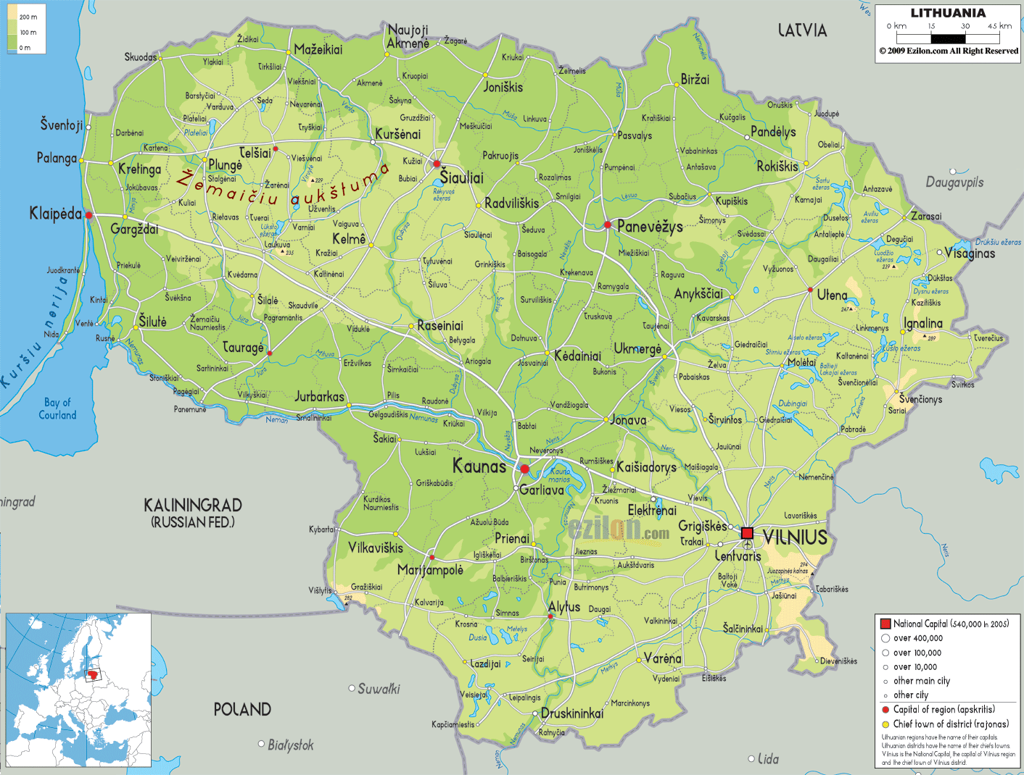
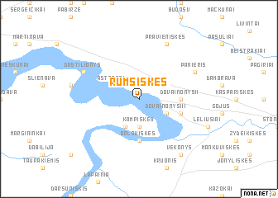
Lithuania Rumšiškės
LOCATION
Source: Map of the country
Source: Map of the area with other sites

Slide 3
Lithuania Rumšiškės
TIPE OF SITE
Open –air ethnographic museum
PHYSICAL AND AESTHETIC FEATURES
The territory of the museum is a very popular place where ethnographic festivals are celebrated and folk song and dance concerts are held.
AREA COVERED
175 ha
HISTORICAL/SCIENTIFIC/ARTISTIC INFORMATION
The museum contains 140 buildings from the 18th–19th century with the restored original interiors and surroundings, whitch are exposed as farmsteads and all of them together represent the main ethnographic regions of Lithuania: Aukstaitija, Samogitia, Dzukija and Suvalkija. The museum is a unique and one of the largest open-air ethnographic museums in Europe (90820 exhibits)
DATING
Museum established in 1966 and opened in 1974)

Slide 4
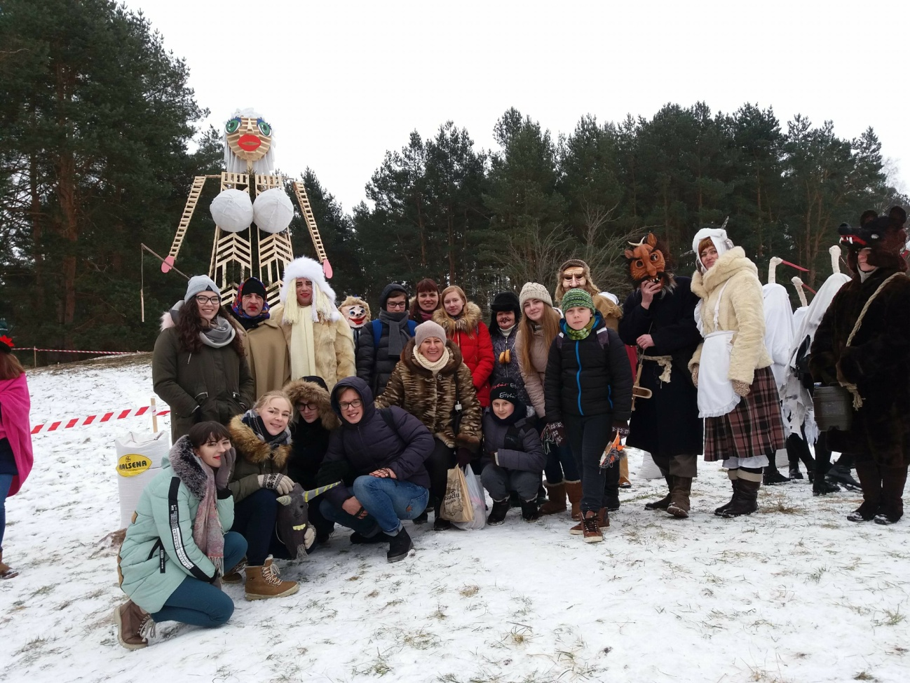
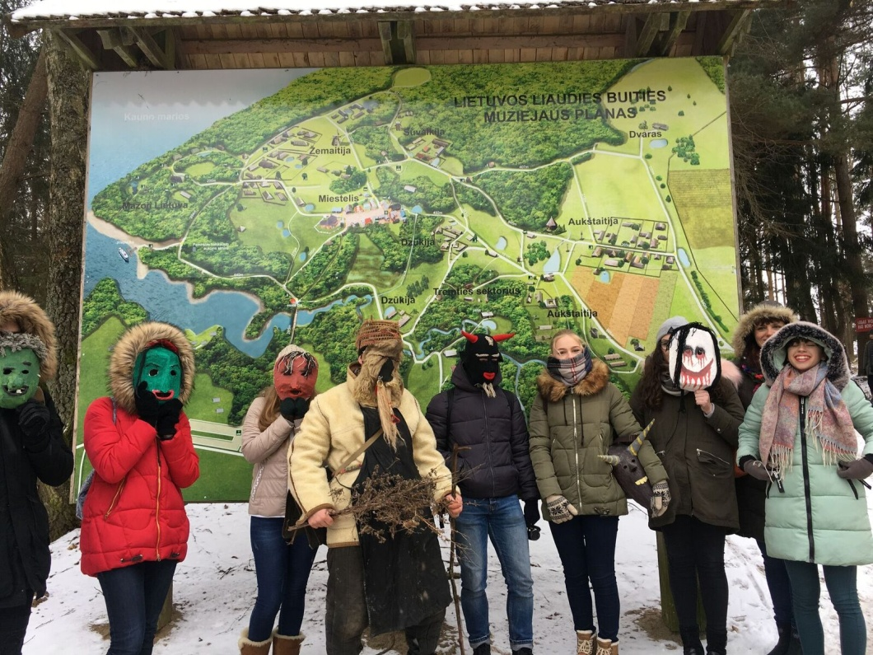
Lithuania Rumšiškės
HIGHLIGHTS
At the map of the museum
Uzgavenes festival (SHROVETIDE FESTIVAL)
in Rumsiskes

Slide 5
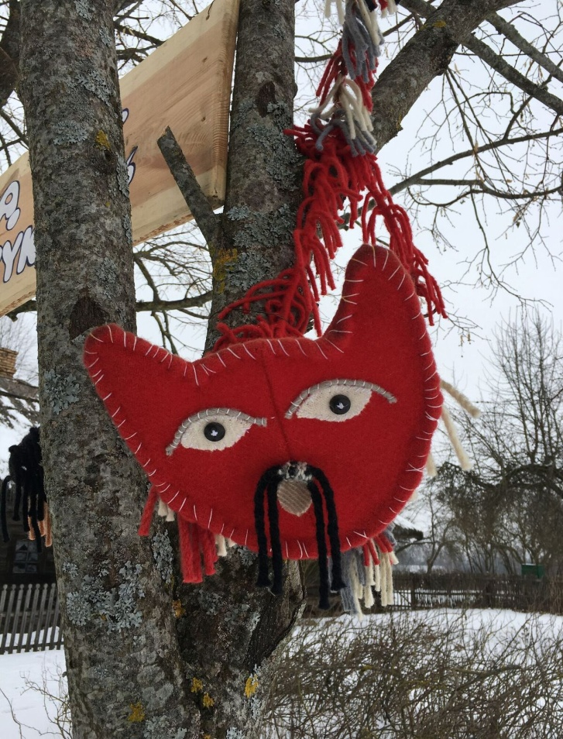
Lithuania Rumšiškės
CONDITION OF PRESERVATION
This heritage is in danger of extinction.
VISITING TIME
Interior expositions are opened May – September: Monday – Sunday, 10 am – 6 pm.
Interior expositions are closed and visiting the museum as a park is available:
15th October – 31st March: Monday – Sunday, 10 am – 4 pm.
April: Monday – Sunday, 10 am – 5 pm.
May – September: Monday – Sunday,
6 pm – 8 pm.
LEGAL OWNERSHIP
Rumsiskes belongs to the Kaunas Reservoir Regional Park
TICKETS AND BOOKING
Adult – 4 EUR;
Schoolchild, student, senior citizen-2 EUR;
GUIDE SERVISE. The guided tours and educational programmes are booked all year round.
Booking telephone +370 346 47392.

Slide 6
Lithuania Rumšiškės
ACCESSIBILITY
The museum is located near the highway A1/E85, Vilnius – Kaunas, 25 km from Kaunas, 79 km from Vilnius
Public transport (buses) are available from Kaunas and Vilnius
All trains from Kaunas and Vilnius to railway station „Pravieniškės“ are available
Every Sunday (from May to September) at 11 a. m., ship goes from Kaunas Lagoon pier near Pažaislis.
Since exposition is set out in a big territory, it can take up to 6 hours to visit the whole museum.
FACILITIES
There are a few B&B, hotels and vocational rentals in the town. You can also stay in the Lithuanian folk museum. There are some small shops there, a few bars and a restaurant on a highway.
Kaunas city is only 18 km away from Rumsiskes.

